Slide 1
Revolutionizing Parking Space Monitoring with IoT Sensors
By
Hano MJ

Slide 2
Designing the IoT Sensor Deployment Plan
Location
Sensor and Network Type
Deployment Strategy
The first step in the design phase is identifying the locations for sensor deployment based on factors such as traffic flow and parking space availability.
Once the locations are identified, the selection of the sensor and network types to be used in each area will be made to ensure optimal performance and coverage.
The deployment strategy will involve integrating with existing parking systems or developing a new system and planning for the infrastructure, power supply, and data management.

Slide 3
Mobile App Interface for Real-Time Parking Availability
Users will receive real-time parking availability data from the sensors.
The mobile app will provide directions to the available parking spots based on their current location or entered address.
The app will allow users to reserve parking spots in advance or be notified when a spot becomes available.
The app will also display the occupancy history and trend analysis.

Slide 4
Raspberry Pi and Sensor Data Collection
IoT sensors will be connected to Raspberry Pi, which will act as the central hub for data collection and processing.
Using MQTT messaging protocol, sensor data will be transmitted to the Raspberry Pi for processing.
The processed data will be stored in a database, and the Raspberry Pi will send updated parking availability data back to the sensors and the mobile app.

Slide 5
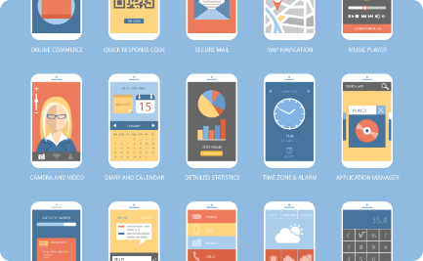
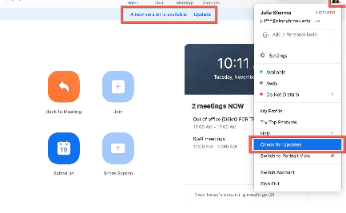
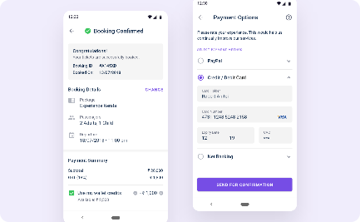
Updating the Mobile App with Available Parking Data
Mobile App Interface
Data Updating
Confirmed Booking
Displays real-time parking availability and enables users to reserve parking spots in advance.
The mobile app will receive parking availability data updates from the sensors and display them in real-time.
The mobile app will allow users to receive confirmation of their parking spot reservation.

Slide 6
Challenges and Opportunities
Technical Challenges
Deployment and management of sensors, real-time data processing, and mobile app development.
Business Opportunities
Potential revenue streams from subscription models, increased parking revenue, and sponsorships from mobility startups.
User-centric Challenges
Vehicle and infrastructure compatibility issues, and user awareness and adoption.

Slide 7
The Future of Parking Management
Making Parking Smarter
Improving User Experience
Exploring New Innovation
The use of IoT sensors provides parking facility managers with real-time insights, enabling them to optimize their operations and make them more efficient.
By providing users with real-time availability data and a seamless parking experience, IoT sensors help in reducing traffic congestion, improving fuel efficiency, and reducing greenhouse gas emissions.
The application of IoT sensors for parking management is just one of the many new and innovative possibilities for the Internet of Things in smart city infrastructure.

